Slide 1



FLIGHT PRICE- PREDICTION PROJECT
Durgadhar Pathak
Internship 15

Slide 2
A positive mindset brings positive things..
- PHILIPP REITER

Slide 3
Problem Statement
Anyone who has booked a flight ticket knows how unexpectedly the prices vary. The cheapest available ticket on a given flight gets more and less expensive over time. This usually happens as an attempt to maximize revenue based on –
1. Time of purchase patterns (making sure last-minute purchases are expensive)
2. Keeping the flight as full as they want it (raising prices on a flight which is filling up in order to reduce sales and hold back inventory for those expensive last-minute expensive purchases)
So, we have to work on a project where we collect data of flight fares with other features and work to make a model to predict fares of flights.

Slide 4
Motivation & Understanding
Motivation:- Flight Price Prediction Project help tourists to find the right flight price based on their needs and also it gives various options and flexibility for travelling. Different features (airline, source, destination, departure & arrival timings, Journey date etc.) helps to understand the flight price variations. Using it airlines also get benefit & required passengers. Also, they will get benefit in scheduling also.
Business Goal:-
First we need to collect flight price data from different websites using web scraping techniques & then need to build a machine learning model.
Target Variable:- Target Variable is Price in this project & it is continuous in nature so we will use Regression algorithms to make our model.

Slide 5
Phases
This project contains three phases:-
Data Collection Phase:-
WE have to scrape at least 1500 rows of data. We can scrape more data as well, it’s up to us, More the data better the model.In this section we have to scrape the data of flights from different websites. The number of columns for data doesn’t have limit, it’s up to us and our creativity. Generally, these columns are airline name, date of journey, source, destination, route, departure time, arrival time, duration, total stops and the target variable price. We can make changes to it, we can add or we can remove some columns, it completely depends on the website from which we are fetching the data.
Data Analysis Phase:-
After cleaning the data, we have to do some analysis on the data. Do airfares change frequently? Do they move in small increments or in large jumps? Do they tend to go up or down over time? What is the best time to buy so that the consumer can save the most by taking the least risk? Does price increase as we get near to departure date? Is Indigo cheaper than Jet Airways? Are morning flights expensive?
Model Building Phase:-
After collecting the data, we need to build a machine learning model. Before model building do all data pre-processing steps. Try different models with different hyper parameters and select the best model.

Slide 6
Steps
Follow the complete life cycle of data science. Include all the steps like.
Data Cleaning
Exploratory Data Analysis
Data Pre-processing
Model Building
Model Evaluation
Selecting the best model

Slide 7
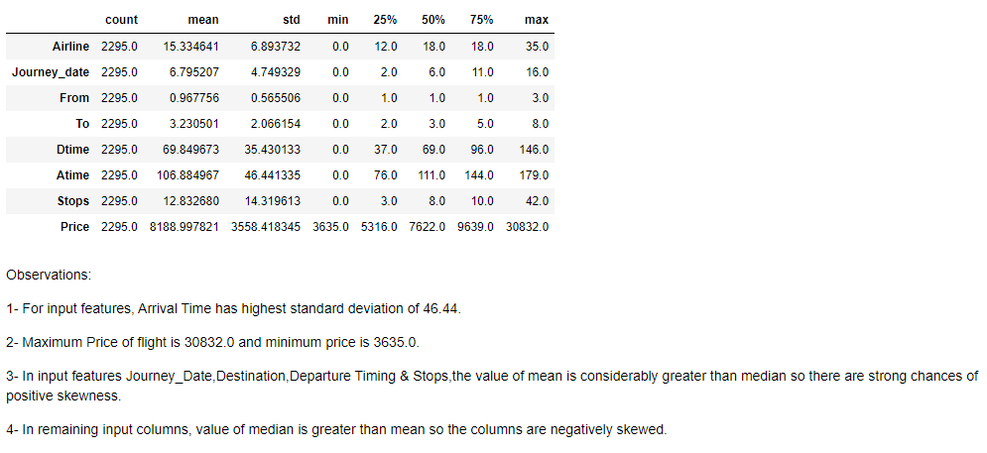
Statistical Summary

Slide 8
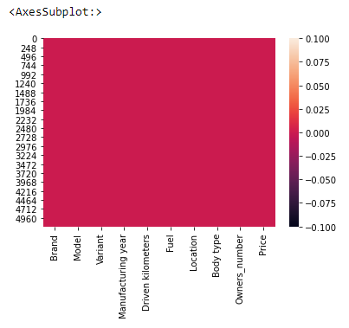
Missing Data
Missing Data: - Missing data are values that are not recorded in a dataset. They can be a single value missing in a single cell or missing of an entire observation. Missing data can occur both in a continuous variable or categorical variable. We had checked missing values in our dataset & dataset has no missing values.

Slide 9
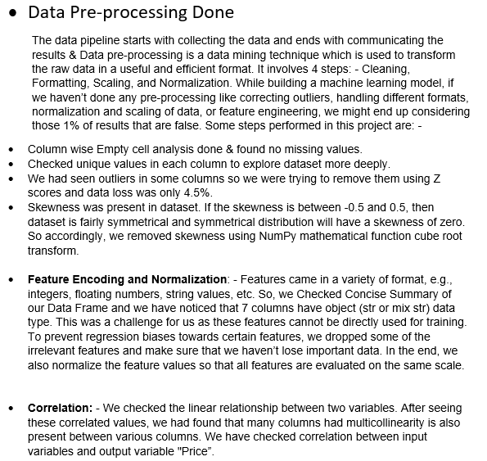
Data Pre-Processing

Slide 10
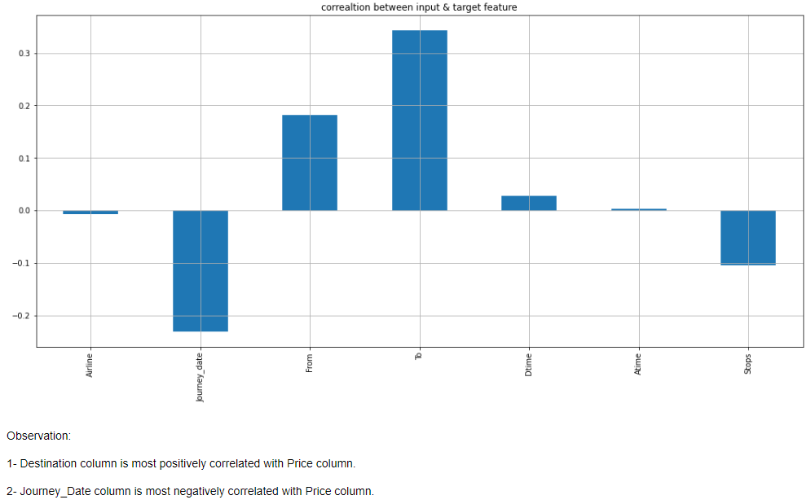
Correlation
Correlation is a statistical measure of how two securities move in relation to each other. We checked the linear relationship between two variables. After seeing these correlated values, we had found that many columns had multicollinearity is also present between various columns. We have checked correlation between input variables and output variable “Price”: -

Slide 11
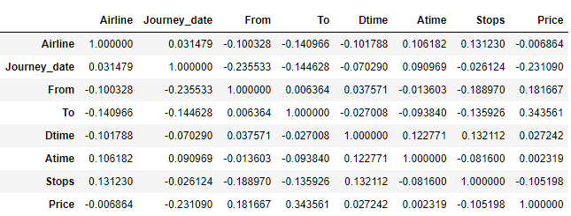
Correlation Matrix
A correlation matrix is a table showing correlation coefficients between variables. Each cell in the table shows the correlation between two variables. A correlation matrix is used to summarize data, as an input into a more advanced analysis, and as a diagnostic for advanced analyses. It consists of rows and columns that show the variables.

Slide 12
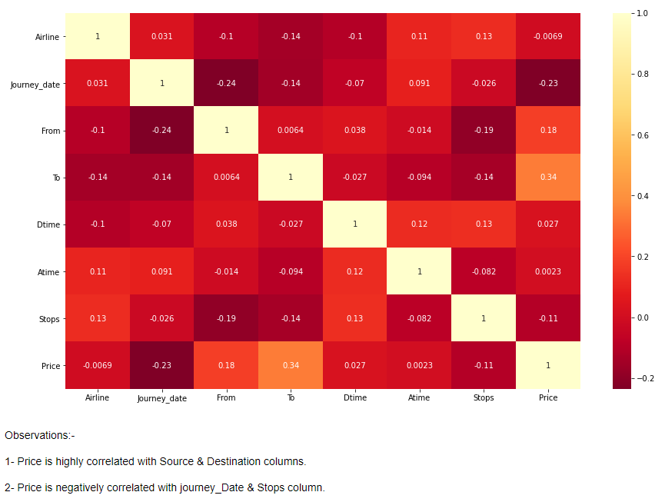
Correlation Matrix using Heatmap

Slide 13
Plotting Outliers
An outlier is an observation that lies an abnormal distance from other values in a random sample from a population. Outliers should be investigated carefully. So, we will use graphical techniques Box Plot for identifying outliers.
Univariate Analysis: - Univariate involves the analysis of a single variable. First, we are going to do univariate analysis using Box Plot method.
Observation: Outliers are present in various columns.

Slide 14
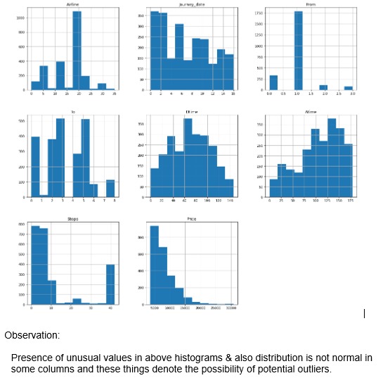
Histogram
Histogram: - we are creating histograms to get broader idea of the distribution.

Slide 15
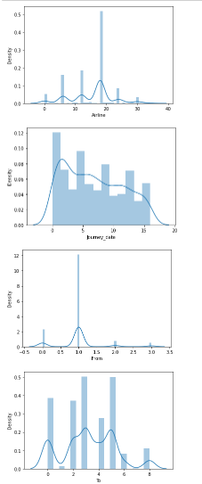
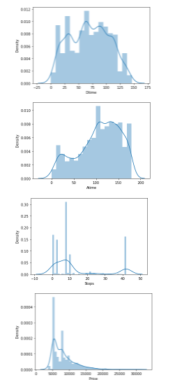
Skewness
Skewness is a measure of asymmetry or distortion of symmetric distribution. It measures the deviation of the given distribution of a random variable from a symmetric distribution, such as normal distribution. A normal distribution is without any skewness, as it is symmetrical on both sides. Hence, a curve is regarded as skewed if it is shifted towards the right or the left. Skewness is of 2 types: - 1- Positive Skewness 2- Negative Skewness.
Distplot to check Distribution of Skewness: - Distplot plots a univariate distribution of observations. The distplot () function combines the matplotlib hist function with the seaborn kde plot () and rug plot () functions. For individual columns we are using Distplot.

Slide 16
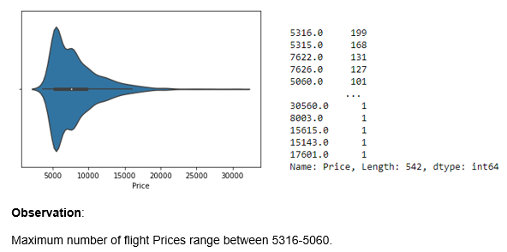
Data Visualizations
Data visualization is the graphical representation of information and data. We have checked visualizations for our input and output features in our dataset.
Exploring Output Feature: - Violin plot for our target variable & value counts are as: -

Slide 17
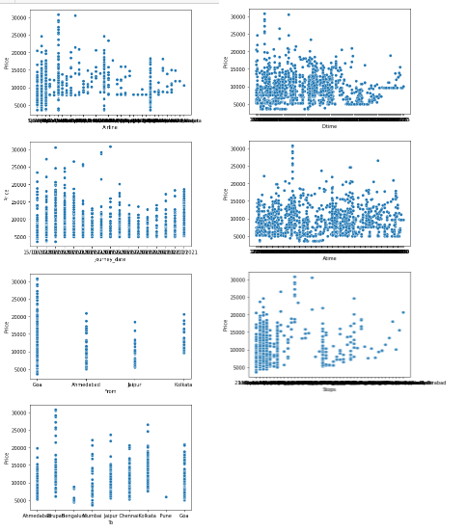
Bivariate analysis
Bivariate Analysis: - It involves the analysis of two variables, for the purpose of determining the empirical relationship between them. We are using scatterplot for this purpose.
Scatter Plot- Scatter plot reveals relationships or association between two variables. Scatter Plot between Output and Input Features: -

Slide 18
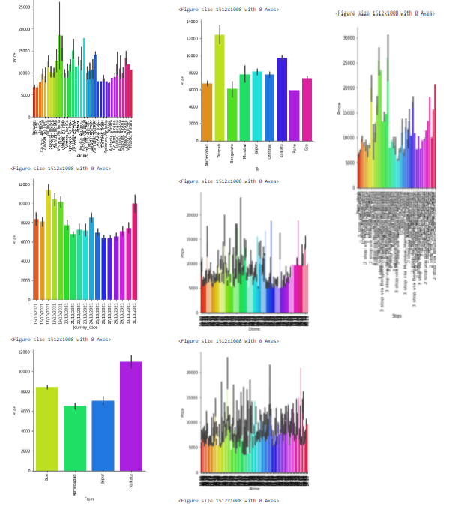
Cat Plot (Categorical Type features)

Slide 19
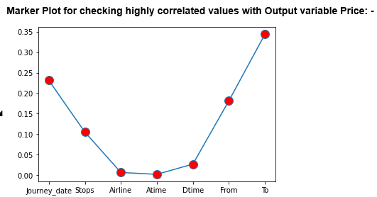
Marker Plot

Slide 20
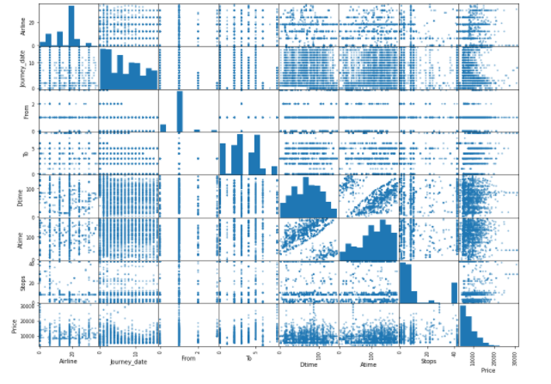
Multivariate Analysis
Multivariate Analysis: - Multivariate analysis is used to study more complex sets of data. It is a statistical method that measures relationships between two or more response variables.
Scatter plot matrix: -Scatter plot matrix is a grid (or matrix) of scatter plots used to visualize bivariate relationships between combinations of variables.
Observation: Using multivariate analysis, we can look at interactions between variables. Scatter plots of all pair of attributes helps us to spot structured relationship between input variables.

Slide 21
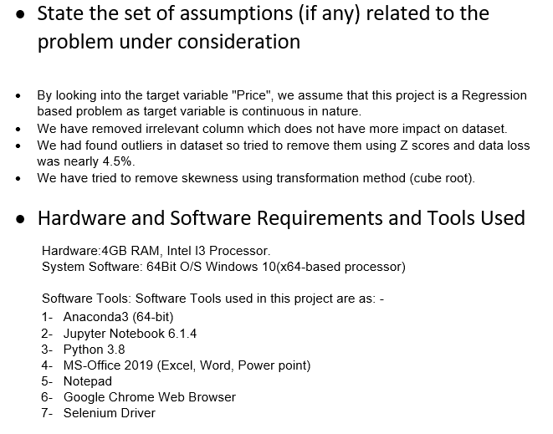
Assumptions & Tools used

Slide 22
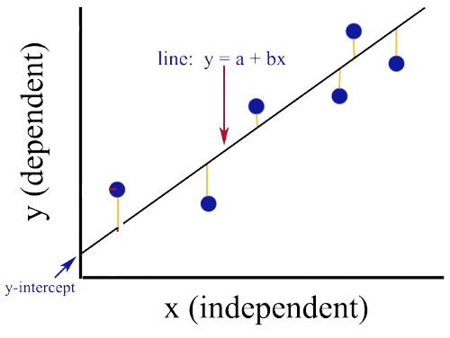
Regression in Machine Learning
Regression in machine learning consists of mathematical methods that allow data scientists to predict a continuous outcome (y) based on the value of one or more predictor variables (x). Linear regression is probably the most popular form of regression analysis because of its ease-of-use in predicting and forecasting. It predicts continuous/real values such as temperature, age, salary, price, etc. Regression is a supervised learning technique which helps in finding the correlation between variables and enables us to predict the continuous output variable based on the one or more predictor variables. In Regression, we plot a graph between the variables which best fits the given datapoints, using this plot, the machine learning model can make predictions about the data. Target variable is continuous in nature so we are using regression algorithms.

Slide 23
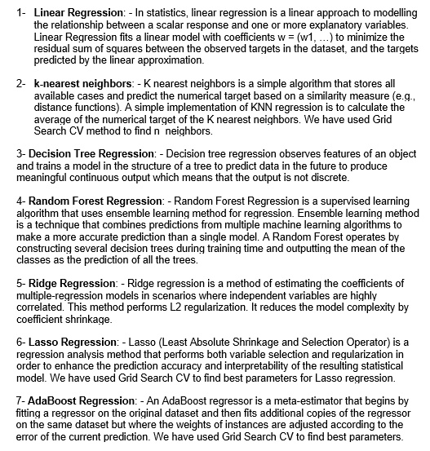
Regression Algorithms used

Slide 24
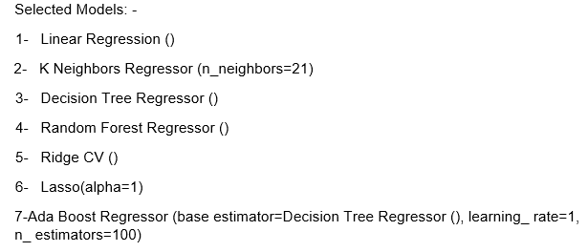
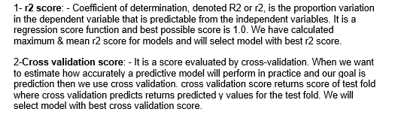
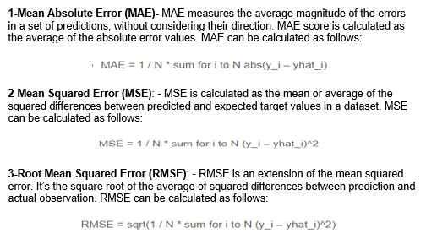
Model selection & Evaluation
Selected Models: -
Evaluation Metrics:-
Error Metrics:-

Slide 25
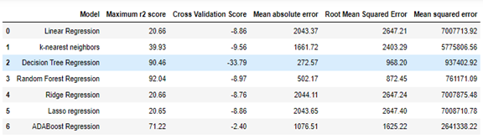
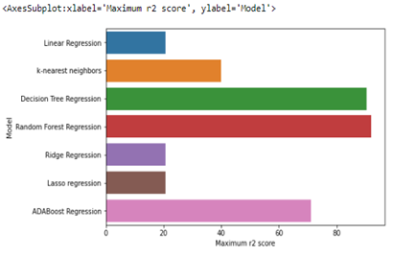
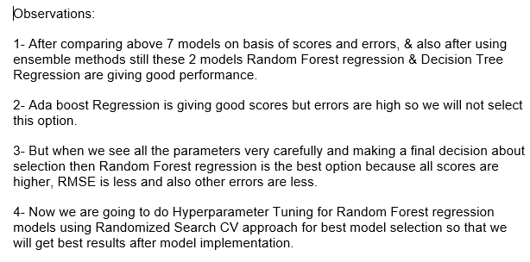
Model Dashboard & Bar Plot

Slide 26
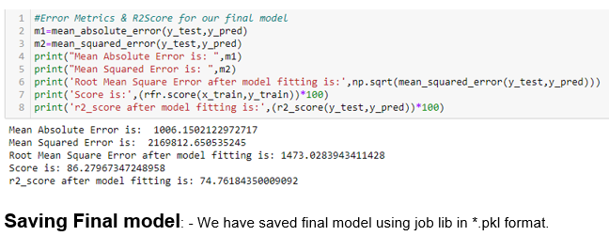
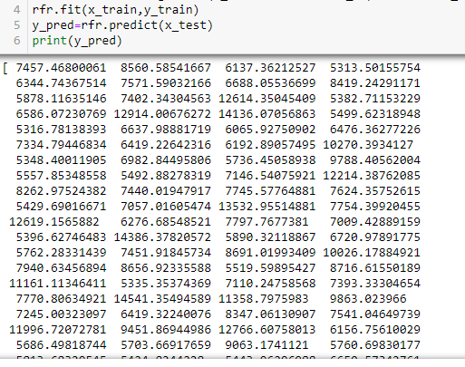
Error Metrics & R2Score after Model Fitting: -

Slide 27
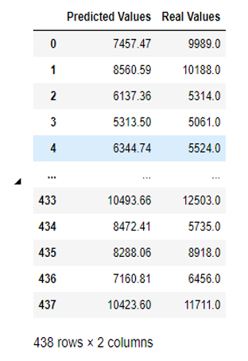
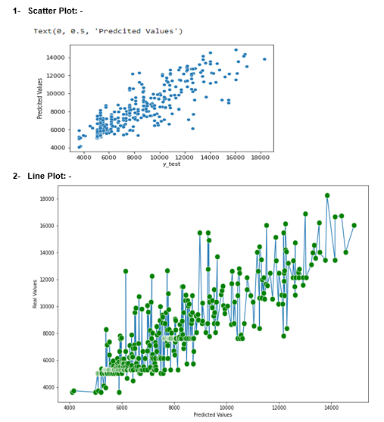
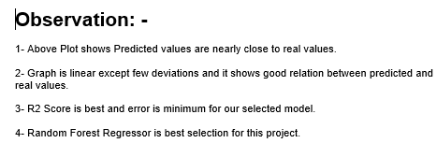
Evaluate Predictions

Slide 28
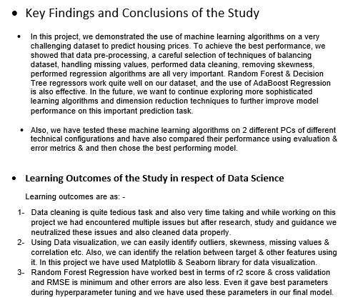
Conclusion

Slide 29
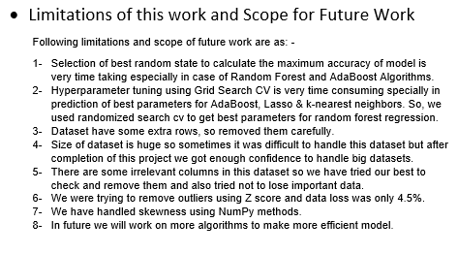
Conclusion 2
Limitations of this work and Scope for Future Work:-
Following limitations and scope of future work are as: -
Selection of best random state to calculate the maximum accuracy of model is very time taking especially in case of Random Forest and AdaBoost Algorithms.
Hyperparameter tuning using Grid Search CV is very time consuming specially in prediction of best parameters for AdaBoost, Lasso & k-nearest neighbors. So, we used randomizd search cv to get best parameters for random forest regression.
Dataset have many missing values so it took huge time & steps to handle this issue.
Size of dataset is huge so sometimes it was difficult to handle this dataset but after completion of this project we got enough confidence to handle big datasets.
There are some irrelevant columns in this dataset so we have tried our best to check and remove them and also tried not to lose important data.
We were trying to remove outliers using Z score but data loss was nearly 60.86%.so, we eliminated this process. In future we will try to use more statistical features.
We have handled skewness using NumPy methods and also performed PCA.
In future we will work on more algorithms to make more efficient model.

Slide 30

Thank You

